Slide 1
Work done
point cloud processing
label selection: filter non-background points
Voxel down sample
remove outlier: radius, statistical
compute normal: nearest neighbor search, Riemannian graph
convex hull
reconstruction methods
ball pivoting
alpha shapes
poisson
DL: point2mesh
mesh processing
Filtering: avg, Laplacian, taubin
subdivision

Slide 2
Point cloud processing
voxel down sampling
remove outlier: radius, statistical
compute normal: nearest neighbor search, consistent tangent plane
convex hull (for DL)
input
After downsampled
Outlier removed
Notes:
Downsampling is important since in most cases I don’t need that many points to get the mesh. It helps saving memory and computation cost. Pointcloud is split into voxel where the points are average to generate the new point cloud.
Remove outlier points:
Normals are crucial to genereate mesh. I tried two methods here. Nearest neighbor search uses several nearest points to estimate the normal, while another method orient the normal with respect to consistent tangent plane. I don’t know much about the second method, but based on my research it performs better at a cost of longer runtime.
Generating convex hull from pointcloud is a preprocessing step for deep learning model. I will get to deep learning in the next slide.

Slide 3
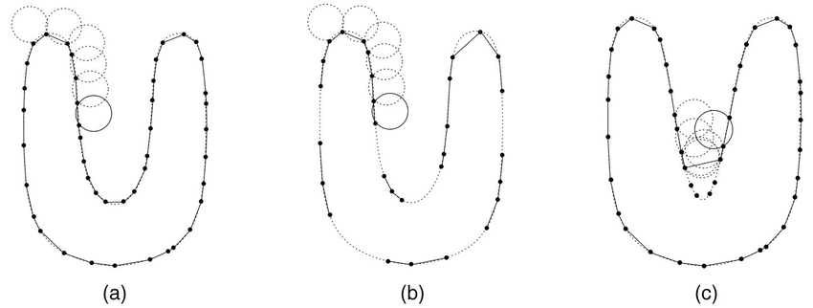
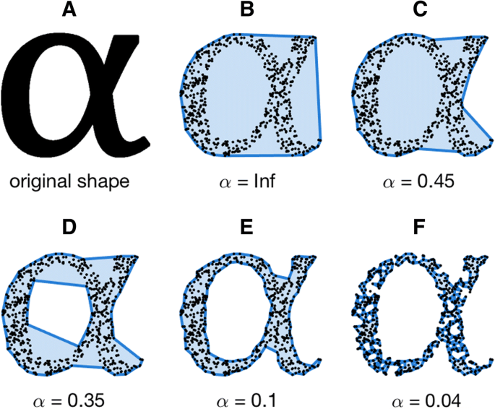
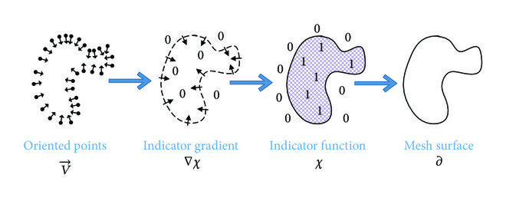
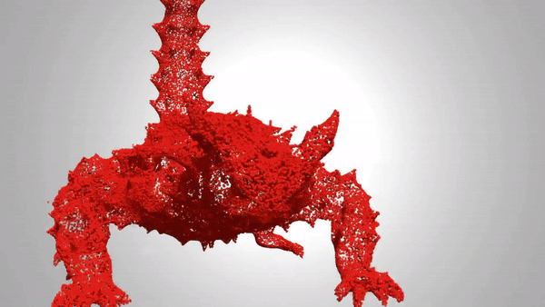
reconstruction methods
ball pivoting
alpha shapes
poisson
DL: point2mesh
1.
2.
3.
4.
Notes:
The principle of the BPA is very simple: Three points form a triangle if a ball of a user-specified radius p touches them without containing any other point. Starting with a seed triangle, the ball pivots around an edge (i.e., it revolves around the edge while keeping in contact with the edge's endpoints) until it touches another point, forming another triangle. The process continues until all reachable edges have been tried, and then starts from another seed triangle, until all points have been considered. The process can then be repeated with a ball of larger radius to handle uneven sampling densities. But it is subjected to noisy points,
I don’t know much about alpha shapes. I know it has one hyperparameter alpha. A large alpha creates more of a convex hull of the point cloud and a small one creates a fragmented mesh.
Poisson algorithm leverages poisson equation and indicator function to obtain the reconstructed surface.
I explored one deep learning approach. The model is called point2mesh. The paper came out in 2020, using input point cloud as prior, the deep network is optimized to shrink-wrap the initial mesh and converges to a desirable shape. From the animation, you can see this lizard-like creature is given as a point cloud and a convex hull mesh. They are fed into the network and eventually the network optimized to produce a good mesh. According to the paper, the network models recurring and correlated structures which is resistant to noise and outliers.

Slide 4
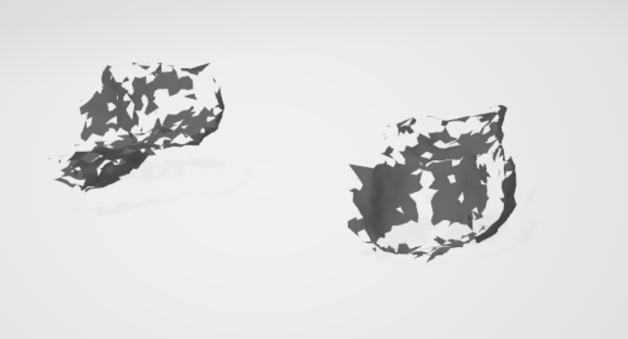
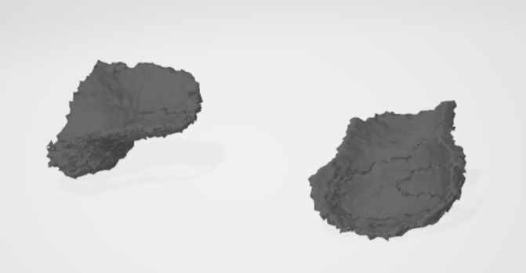
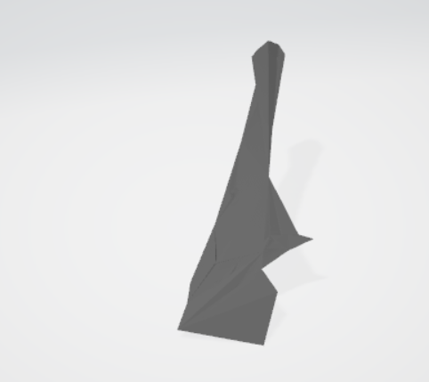
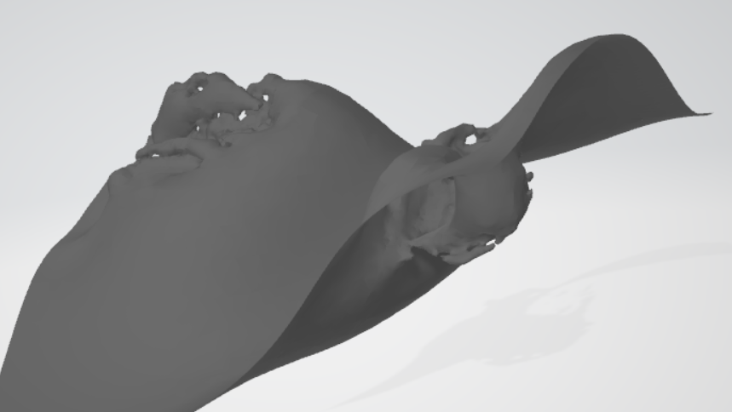
reconstruction methods
ball pivoting
alpha shapes
poisson
DL: point2mesh
1.
2.
3.
4.
Notes:
The principle of the BPA is very simple: Three points form a triangle if a ball of a user-specified radius p touches them without containing any other point. Starting with a seed triangle, the ball pivots around an edge (i.e., it revolves around the edge while keeping in contact with the edge's endpoints) until it touches another point, forming another triangle. The process continues until all reachable edges have been tried, and then starts from another seed triangle, until all points have been considered. The process can then be repeated with a ball of larger radius to handle uneven sampling densities. But it is subjected to noisy points,
I don’t know much about alpha shapes. I know it has one hyperparameter alpha. A large alpha creates more of a convex hull of the point cloud and a small one creates a fragmented mesh.
Poisson algorithm leverages poisson equation and indicator function to obtain the reconstructed surface.
I explored one deep learning approach. The model is called point2mesh. The paper came out in 2020, using input point cloud as prior, the deep network is optimized to shrink-wrap the initial mesh and converges to a desirable shape. From the animation, you can see this lizard-like creature is given as a point cloud and a convex hull mesh. They are fed into the network and eventually the network optimized to produce a good mesh. According to the paper, the network models recurring and correlated structures which is resistant to noise and outliers.

Slide 5
mesh processing
filtering: avg, Laplacian, taubin
subdivision
Avg
Laplacian
Taubin

Slide 6
Pipeline
point cloud processing
label selection
Voxel down sample
remove outlier: radius
compute normal: nearest neighbor search
convex hull
reconstruction methods
alpha shapes
mesh processing
Filtering: Laplacian
subdivision

Slide 7
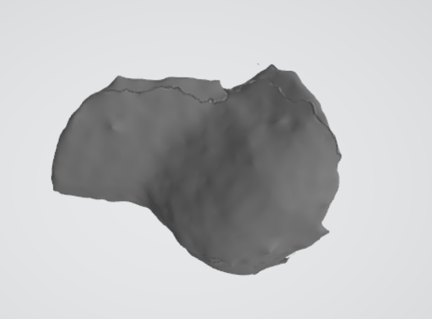
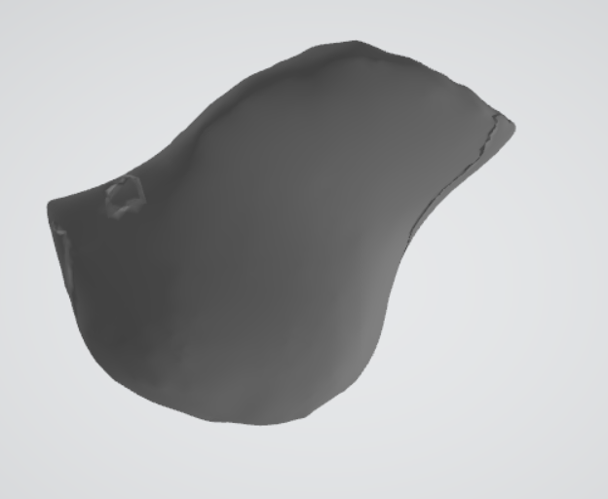
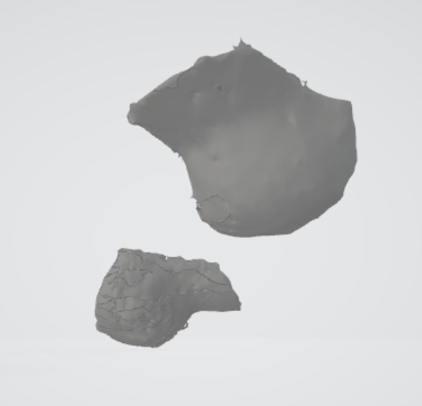
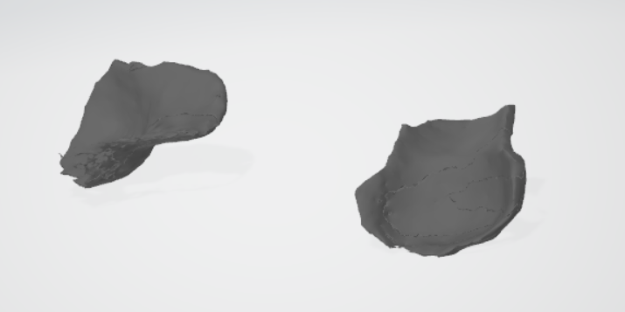
Result
Kitchen_1
desk_1
table_1
Meeting_room_1

Slide 8
Results
Method | Average Time(s)*
Ball pivoting | 39
Alpha shape | 2
Poisson | 2
DL: point2mesh | 1491
*The above methods were run on the caps(label 2) in the 4 scences: desk, kitchen_small, meeting_room and table. Runtime were recorded and averaged.

Slide 9
Results
Method | IOU | Chamfer distance (L1 and L2) | Normal consistency | F-score
Ball pivoting
Alpha shape
Poisson
DL: point2mesh
*The above methods were run on the caps(label 2) in the 4 scences: desk, kitchen_small, meeting_room and table. Runtime were recorded and averaged.

Slide 10
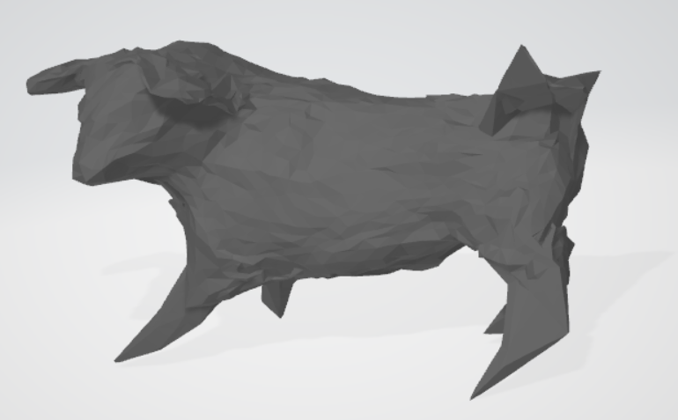
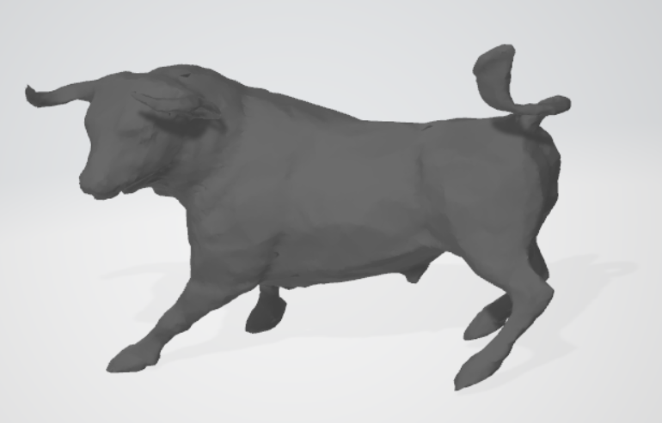
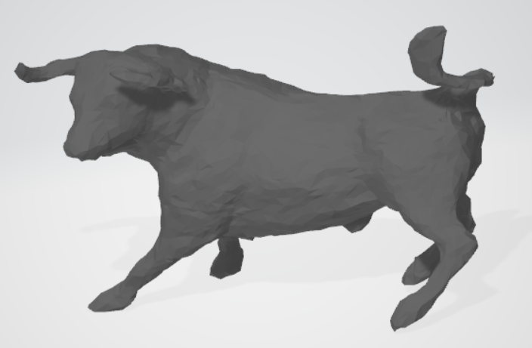
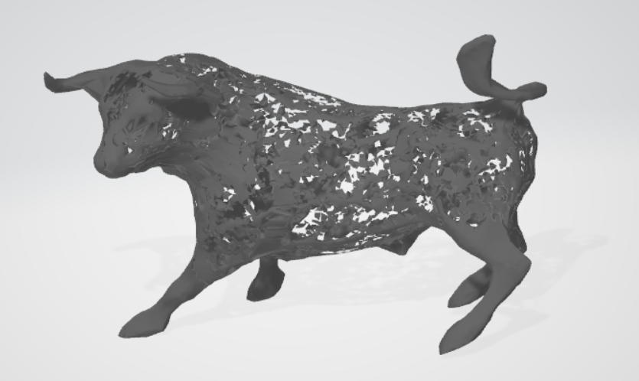
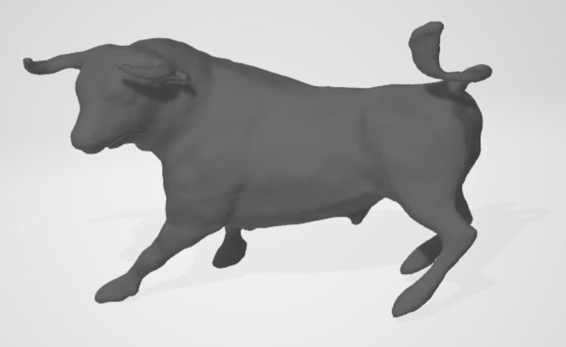
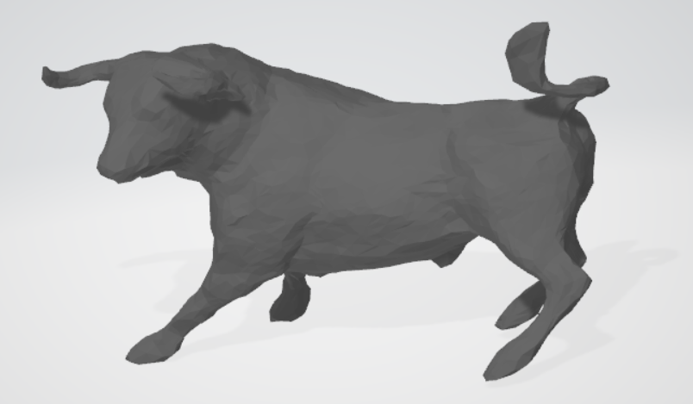
More Results
Ball pivoting
DL 1000 epochs
Alpha shape
DL 3000 epochs
poisson
DL 6000 epochs

Slide 11
Conclusion
Alpha shape reconstruction works best
Ball pivoting cannot produce complete surface, while poisson produce excessive surface
DL is the worst
Mesh quality depends largely on point cloud (dataset) quality, so point cloud processing is important
Mesh processing is also important to get a smooth, watertight surface

